Slide 1

DunkDiggers
Group 5
UMD Basketball
Database Management Systems
16 March 2024

Slide 2




Meet Our Team
Raunak Singh
Dhruvin Shah
Nilay Somani
Alex Nitzl

Slide 3

Background
The database management system developed by the DunkDiggers team aims to assist users of the UMD Basketball team, including Managers, Players and Support staff such as Coaches, Video Analysts, and Scouting Coordinators to streamline the process of evaluating player performance and formulating game strategies based on this evaluation.
DunkDiggers team utilizes data from the UMD Terps Basketball Stats data as present over: https://umterps.com/sports/mens-basketball/stats/2023-24

Slide 4


Mission Statement
Evaluate player performance
Game preparedness
Enabling the team manager and support staff with a framework to analyze, evaluate, and enhance player performance
Providing a user-friendly platform that facilitates informed decision-making, strategic planning, and effective game preparedness for upcoming matches.

Slide 5



Mission Objective
Strategic team selection
To analyze player performance data, historical trends, and match dynamics to make informed decisions on team selection for each game. This will ensure that the best lineup is chosen to maximize the team's chances of success.
Assessment for training management
With performance metrics, personalized assessments for each player. By identifying strengths and areas for improvement, training plans can be tailored to enhance individual skills and overall team performance.
Optimizing gameplay
Utilize historical game statistics on how different gameplay styles effectively work in matches. This information will be used to optimize player roles within the team structure, ensuring that each player is directed to contribute in adequate attacking/defensive proportions for an effective all round performance of the team.

Slide 6
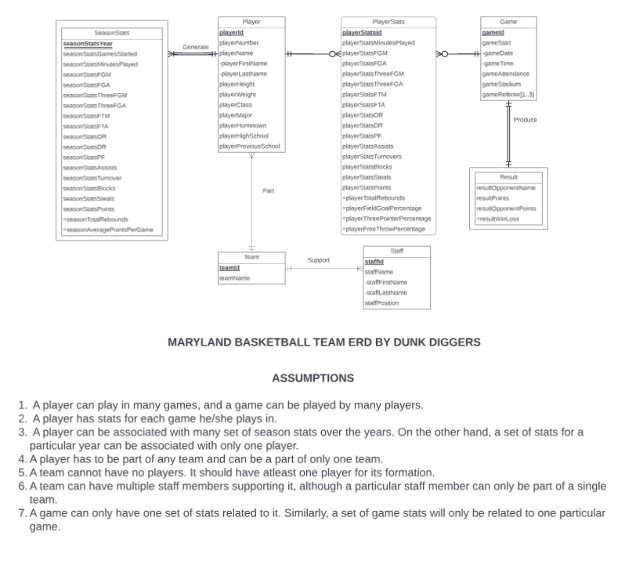
Conceptual Database Design
ER Diagram
The Entity Relationship Diagram captures the relationship between the various entities involved in UMD basketball database which helps in developing the Relational Schema and in visualizing the structure of the database system.

Slide 7
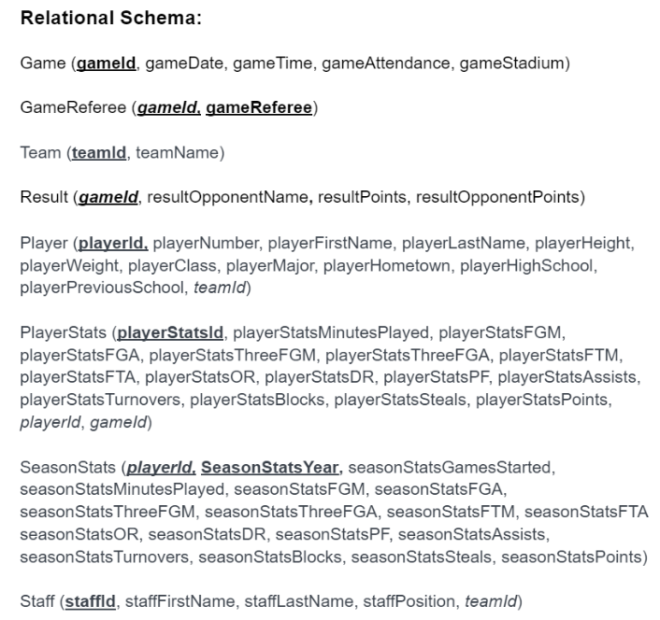
Logical Database Design
Relational Schema
Relational Schema is the logical schema of the entire UMD basketball database providing details about the tables, attributes, primary and foreign keys.The final step in logical database design is to transform the combined and reconciled data specifications into basic, or atomic, elements following well-established rules for well-structured data specifications.

Slide 8
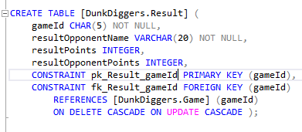
Physical Database Design
Dunk Diggers Result Table
The result table will have attributes for storing the opponent's name, the teams, as well as the opponent's points. Both points attributes will be used for creating a view to determine the result (Win or Loss)
The primary key will consist of attribute gameId which can independently uniquely identify the game result rows.
Additionally, the attribute gameId will be a foreign key from the table Game.
In case a game result is updated or deleted, the matching game row in the parent Game table will be updated or deleted as well.

Slide 9
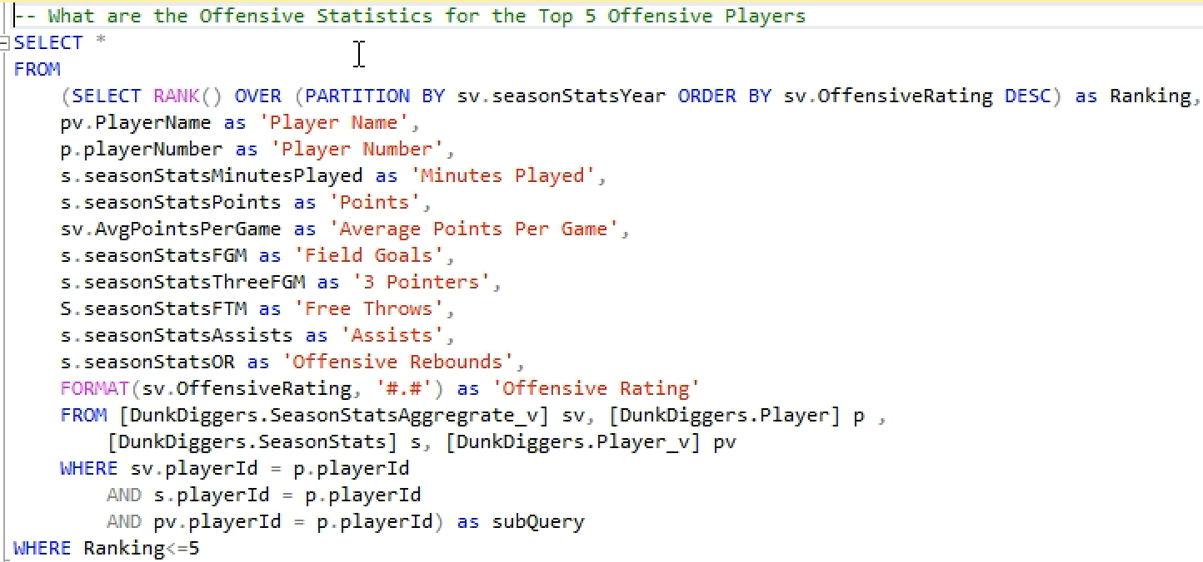
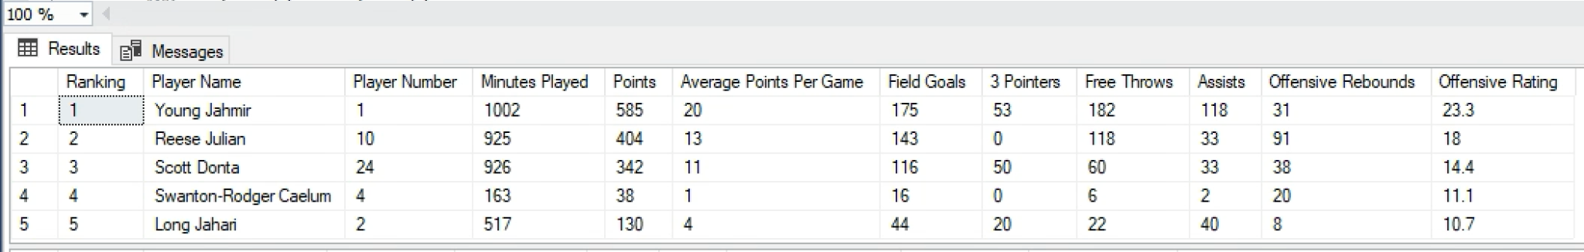
Business Transactions
What are the Offensive statistics of the top 5 players?
Team Selection for Offensive Players
Targeted Practice based on the different aspects of the game
Team combination can be determined based on offensive efficiency of top players

Slide 10
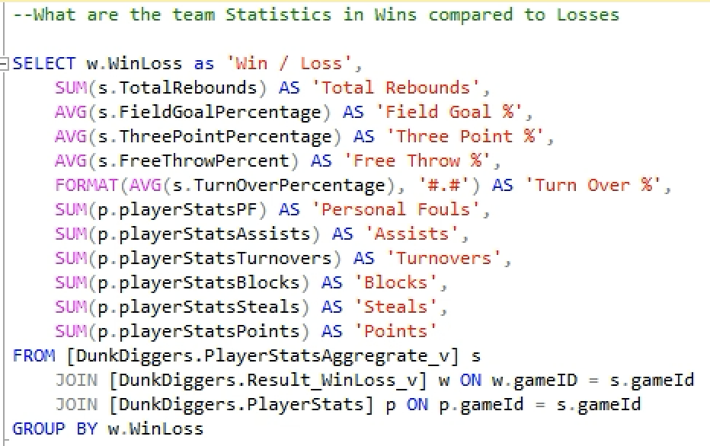
Business Transactions
What are the team statistics in Wins Compare to Losses?
Identify the areas of improvement
Identify areas of strength
Targeted Practice based on the different aspects of the game

Slide 11

THANK YOU
Data Analytics isn’t just a Game Changer,
it's a Game Winner!!

